Slide 1
Computational Photography
Assignment #5
Panoramas
Deliang Yin
Fall 2017
CS 6475

Slide 2
Report Guidelines
You must use the templates provided for your report, but you may customize them (reduce font size, reply in paragraph or column formats, add illustrations and extra images to aid your explanations, change the background, delete notes such as this page, etc.). You may delete optional slides if they are unused in your report.
Remove instructor notes (usually in red) from your reports (but keep question prompts).
Replace blue typing with your answers
You may add pages as necessary to best present your work. We like images, but resize each image to 2MB or less before pasting them into the template to reduce file size and make grading easier.
We expect graduate-level answers that provide clear explanations. Short, simplistic answers will not receive full credit. You may need to do research beyond just watching the class videos and reading the technical resource papers.
When you are done, convert your template report to PDF and then check it! Students often end up with lines cut off on page bottoms, and we will not accept replacement work. We can only grade what appears in the report.
DELETE THIS SLIDE
CS 6475

Slide 3
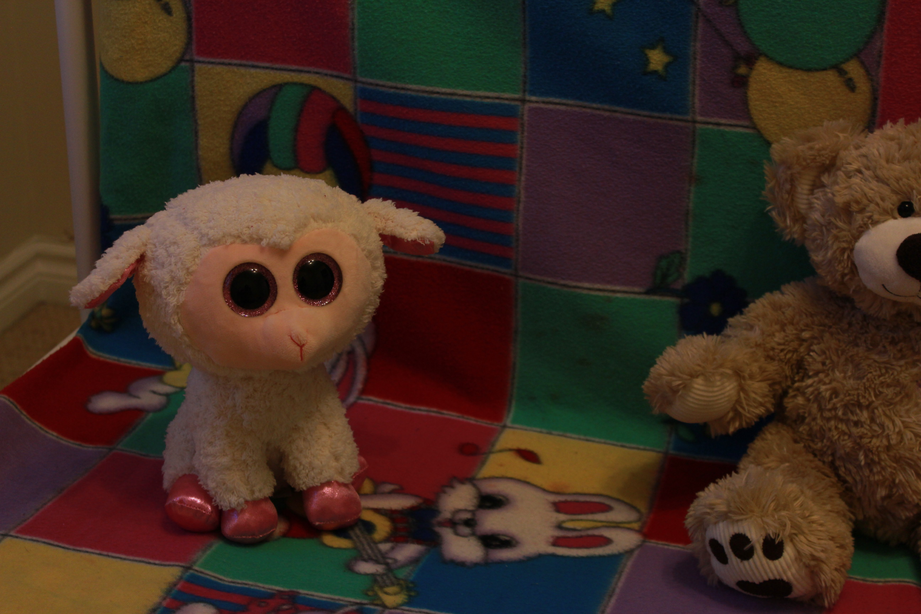
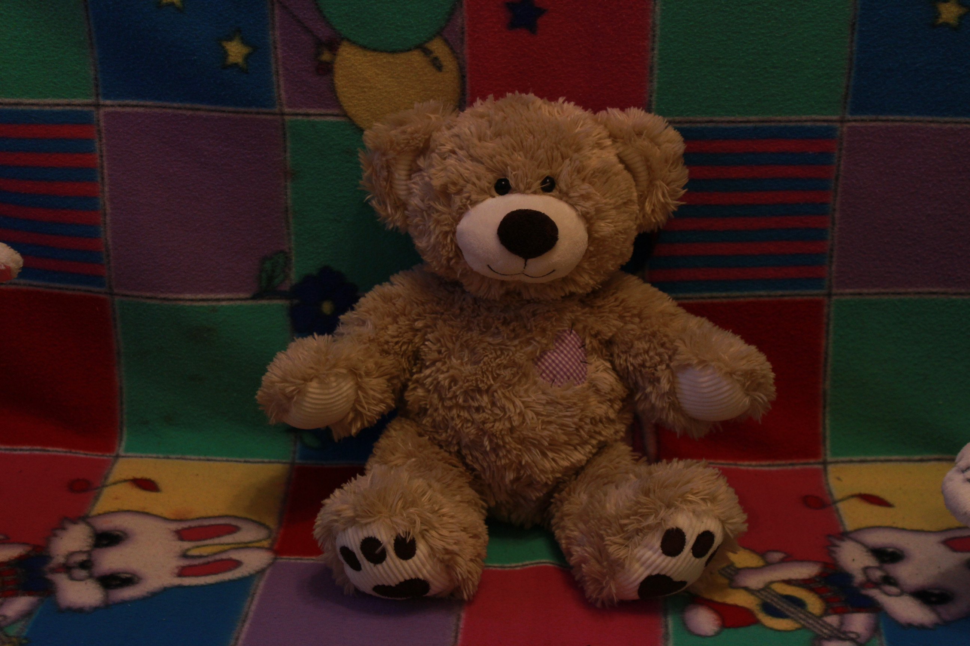
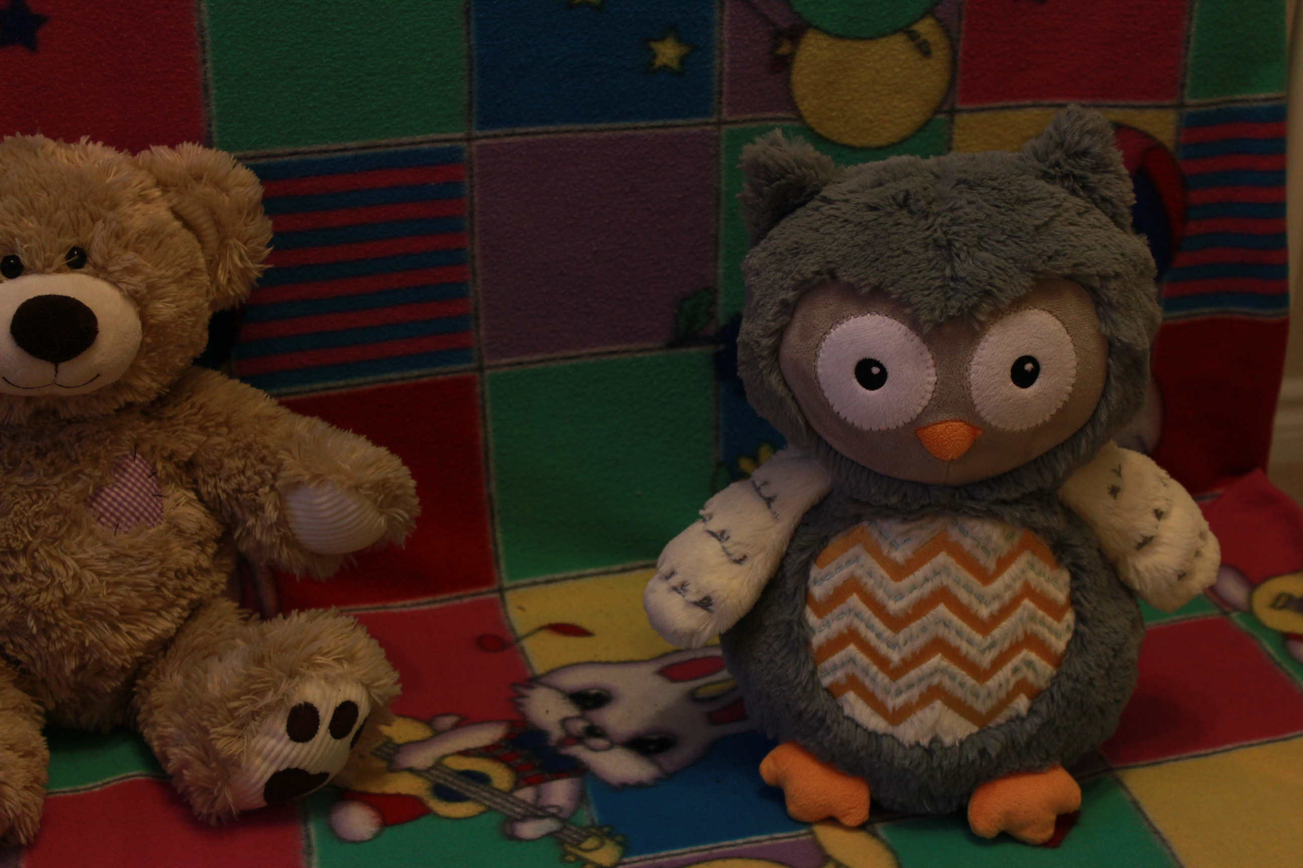
Original Input Images
Show the images used for your own panorama. These should be images that you took. Remember, a minimum of 3 images is required
Sheep
Bear
Sheep
CS 6475

Slide 4
The Scene
Describe the scene that you captured
City, State, Country – Oakville, Ontario, Canada
Date and time – OCTOBER 15, 2017 5:43PM
Context – Inspired by professor’s lecture about stitiching Einstein and DaVinci , I decided to take photos of three fellow friends of my new baby: Sheep, Bear, and Owl, and put them together on the same image.
CS 6475

Slide 5
Basic Set-up
What camera did you use?
Canon EOS REBEL T3i
What were the camera settings that you used? Aperture, Exposure time, and ISO are required. You may include additional settings
Aperture (f-xx): f/5
Exposure time: 1/50 sec.
ISO: 400
Focal length: 39mm
CS 6475

Slide 6
Setup and Panorama Type
Describe your setup for your camera, and the camera movement that you used when you took your pictures.
As shown in the next slide, I took panorama images on my bed.
Step 1: I first put my sheet on the bed shelf to serve as background
Step 2: I put 3 fellow friends on the same side on the bed sheet
Step 3: I put my camera on the tripod, and turn to manual mode and set the camera parameters.
Step 4: I horizontally rotate the camera and take the panorama images with the same camera settings.
CS 6475

Slide 7
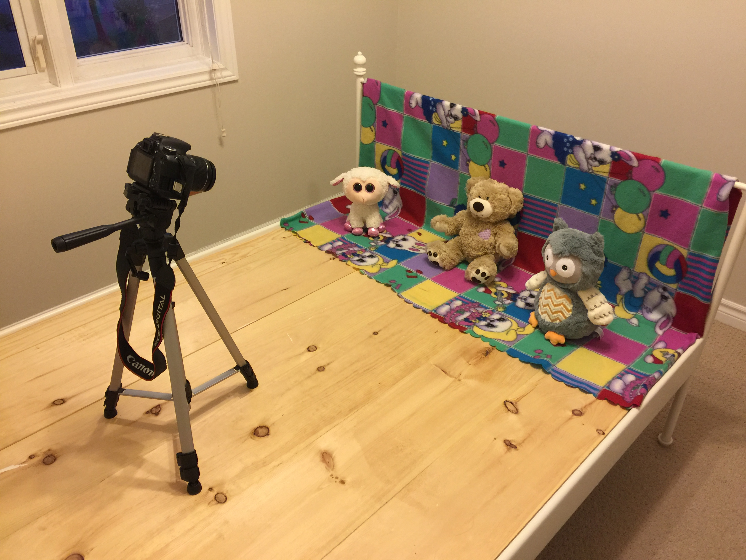
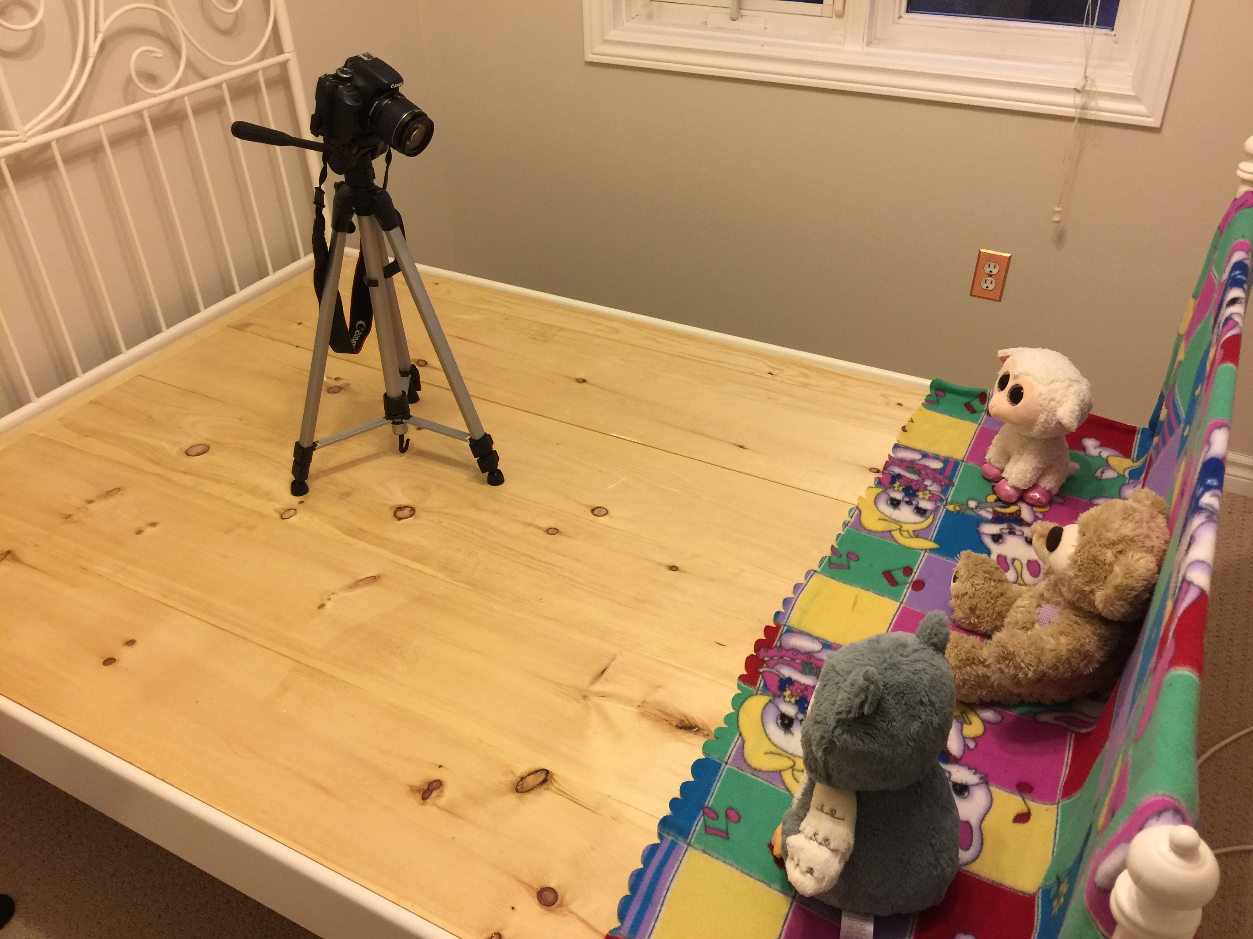
Setup and Panorama Type
CS 6475

Slide 8
Setup and Panorama Type
What kind of panorama did you make?
It is Planar perspective motion Based on section 9.1 motion models in Szeliski’s book.
CS 6475

Slide 9
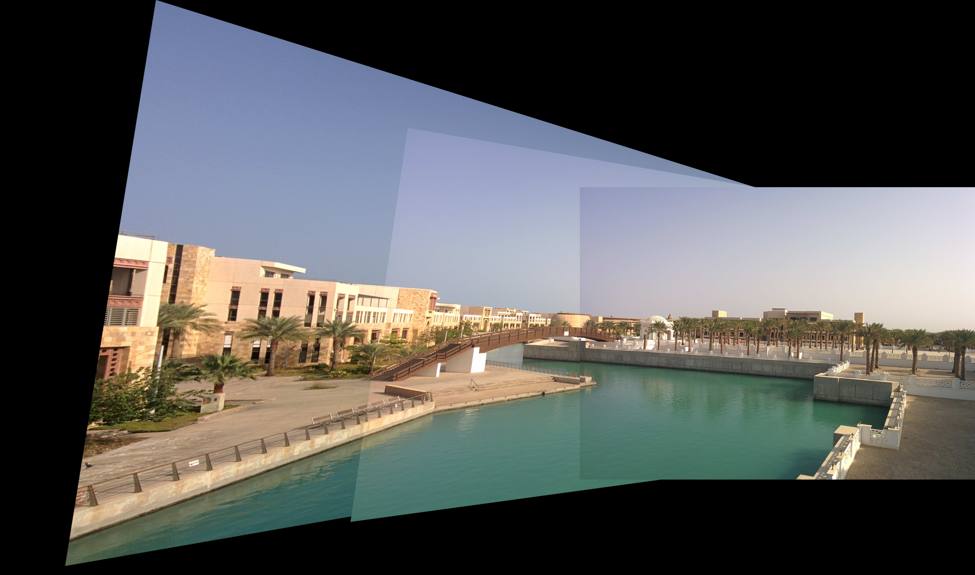
Results - Test Images
Show the resulting panorama from the images we provided.
CS 6475

Slide 10
Test Images - Discussion
Are you satisfied with the result? Why or why not? Give details of what you were and/or were not happy with
I am happy that these images appear in the right position and align with each other, so that the duplicated areas overlap each other.
I am not happy about the transition between images and the huge black background left in the canvas. I can see obvious banding in the sky and the lake, as the exposure/color tone significantly change between images using alpha blending.
CS 6475

Slide 11
Test Images - Discussion
Were you able to achieve a smooth transition between images?
Simply using the alpha blending may not work, as the blending itself does not change the intensity values.
I guess, one possible solution to achieve a smooth transition is:
Step 1: to adjust the intensity values of the 2nd and 3rd image, so that the average intensity values of these three images are the same.
Step 2: using different blending methods other than alpha blending. For example, the one used in the blending homework.
Another way is to use Poisson blending, which I will show in the A&B section.
CS 6475

Slide 12
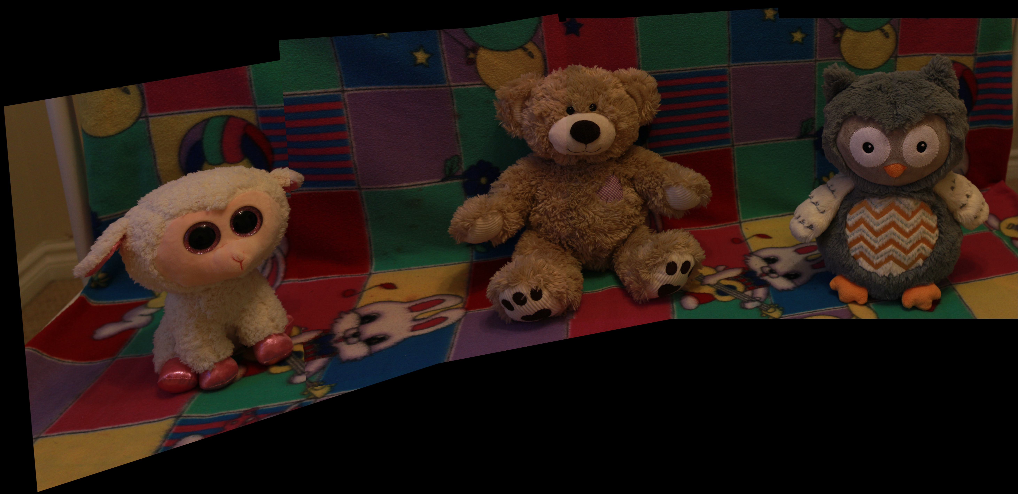
Results - Original Images
Show the resulting panorama from the images that you took.
CS 6475

Slide 13
Original Images - Discussion
Are you satisfied with the result? Why or why not? Give details of what you were and/or were not happy with.
I am happy that these three images align with each other, and now three fellows are stitched in the same image.
I am not happy that I still can see the edges on bear’s face, where these images are stitched together. In addition, the images are relatively dark. I should’ve increased the exposure
Were you able to achieve a smooth transition between images?
I just used alpha blending as the starting point, and there are edges found on bear’s face. I will use Poisson blending in A&B section, which is expected to achieve a smooth transtion between images.
CS 6475

Slide 14
Effect of changing the number of matches in findMatchesBetweenImages()
Answer the following questions:
What size are your own images in pixels (height x width)?
Height x width = 1728 pixels x 2582 pixels
What effects do changing the number of keypoints and matched features have on your output?
Try a minimum of 4 value pairs and present your resulting image outputs (see next slide). Discuss your findings here, use additional slides.
CS 6475

Slide 15

findMatchesBetweenImages()
Replace the blank images with your own uncropped outputs and provide the value of keypoints and num_matches for each. A minimum of 4 is required, but you may present more to help in your discussion
# of keypoints = xxx num_matches= xx
# of keypoints = xxx num_matches= xx
# of keypoints = xxx num_matches= xx
# of keypoints = xxx num_matches= xx
CS 6475

Slide 16
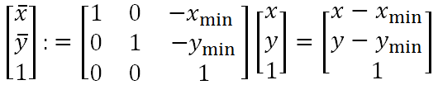
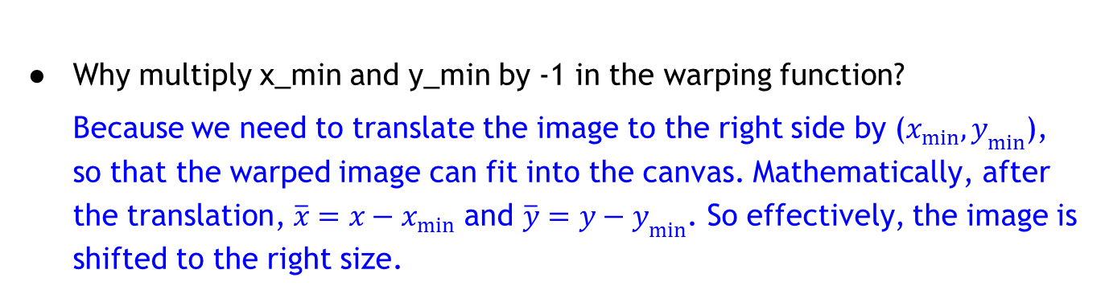
warpCanvas()
Why multiply x_min and y_min by ‐1 in the warping function?
Because we need to translate the image to the right side by ($x_{min},y_{min}$), so that the warped image can fit into the canvas. Mathematically, after the translation, $\overline{x}=x−x_{min}$ and $\overline{y}=y−y_{min}$. So effectively, the image is shifted to the right size.
CS 6475

Slide 17
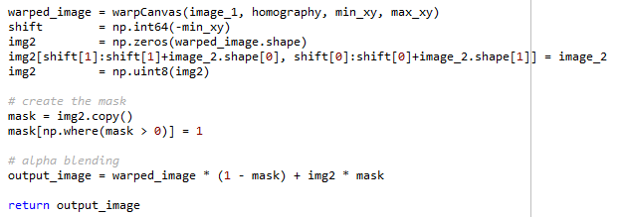
blendImagePair()
Discuss your implementation for blendImagePair().
I attached my code below, and see discussioin in the next slide
CS 6475

Slide 18
blendImagePair()
Discuss your implementation for blendImagePair().
Step 1: Warp the image 1 and put in the canvas large enough to hold both warped image 1 and image 2
Step 2: Copy the canvas and put in image 2
Step 3: Create the mask, so that it’s 1 if it sits on image 2, and 0 in the remaining area
Step 4: Using alpha blending with mask serves as the weight
CS 6475

Slide 19
Discussion & Analysis
What worked well with your blend? Be specific.
This blend simply applied alpha blending method, and stitched images together. It can avoids ghost effect by using 100% weight on the second image for the common areas.
What did not work well with your blend? If you have any blending results that failed, include the images and discuss what went wrong.
There are sharp edges on bear’s face. During my work, I have several failed results. Below are just two examples.
The intensity values are signed integers, which could be negative. I converted to numpy.unit8, and it works!
I used equal weight on the common areas of image 1 and image 2. there would be ghost effects on the common area. Therefore, I updated the weight to be 100% for image 2.
Were there any problems you couldn’t solve? What were they? If you had more time, how would you solve these problems?
Were you happy with your result? If so/not, why? Be specific.
What could you do differently and how would you go about doing it? Do not say there is nothing you could do differently. There’s always a way to improve.
CS 6475

Slide 20
Discussion & Analysis
Were there any problems you couldn’t solve? What were they? If you had more time, how would you solve these problems?
Were you happy with your result? If so/not, why? Be specific.
Generally I am happy that three images are stitched togather.
What could you do differently and how would you go about doing it? Do not say there is nothing you could do differently. There’s always a way to improve.
CS 6475

Slide 21
Above and Beyond (read before removal)
See the 90% rule
blendImagePair() is the main focus in grading the A&B section of this assignment, although other topics may be explored. You may earn A&B points by implementing and explaining a spectacular blending function (both horizontal and vertical). Effectively, this means that this function is worth 10 basic assignment points, and can be worth up to 20 points with full A&B credit.
Do not confuse this with the assignment blending requirements:
For blendImagePair(), the basic code requirement is to replace the insertion blend with your own implementation that results in a blend that is an improvement upon our sample blend.

Slide 22
Resources
Include technical resources that you relied on.
Stack overflow
Websites
Technical papers
Significant Piazza posts
Links to other outside sources you may have used
Remember: It’s plagiarism if you don’t reference it!

